Slide 1

B.Tech Project Evaluation - 3
NYAYSETU: AN AI-ASSISTED LEGAL SUGGESTION SYSTEM
Presented by :
Anupam Kumar Singh (2023305089)
Akshay Pratap Singh (2023409091)
Prince Kumar (2023284684)
Under the Supervision of:-
Prof. (Dr.) Velayudham Sathiyasuntharam
Professor, CSE
DEPARTMENT OF COMPUTER SCIENCE & ENGINEERING
SHARDA SCHOOL OF ENGINEERING AND TECHNOLOGY
October 2026

Slide 2
Approval from guide for the evaluation

Slide 3
Contents of the Presentation
Introduction to the project
Motivation for the project
Problem Statements/Objectives of the Project
Literature Survey
Meeting details
Workload distribution/ Team Work
Project Planning
Methodology used
Solution Approach
Algorithms and framework
Outcome Produced
Proof of the Outcome

Slide 4
Introduction of the project
NyaySetu is an AI-assisted legal suggestion system intended to make preliminary legal information easier to access.
Users can describe a concern in everyday language instead of needing formal legal terminology.
The proposed workflow identifies a relevant legal category, retrieves grounded information and presents an understandable preliminary response.
The platform is also designed to help users discover legal professionals by profile and specialization.
NyaySetu is an informational support tool; it does not replace a qualified lawyer or create an advocate–client relationship.
User concern
Natural-language description
NyaySetu
Classification + information
Next step
Relevant lawyer / referral

Slide 5
Motivation for the Project
Legal processes and terminology can be difficult to understand, particularly for people without legal training.
Cost, location and limited awareness can prevent people from finding reliable initial information.
People naturally explain problems in their own words; systems that require legal keywords create an additional barrier.
A guided first step can help users understand the likely category of a concern and decide when professional advice is needed.
The project is motivated by accessibility, clarity, responsible use of AI and a practical bridge to human legal expertise.
Design principle: accessible information first — qualified legal advice when needed.
5

Slide 6
Project Objectives
Legal processes and terminology can be difficult to understand, particularly for people without legal training.
Cost, location and limited awareness can prevent people from finding reliable initial information.
People naturally explain problems in their own words; systems that require legal keywords create an additional barrier.
A guided first step can help users understand the likely category of a concern and decide when professional advice is needed.
The project is motivated by accessibility, clarity, responsible use of AI and a practical bridge to human legal expertise.

Slide 7
Literature Survey (1/2)
Paper | Author | Year | Problem Addressed | Method Used | Key Contribution | Limitation
Text Classification: A Survey | Fabrizio Sebastiani | 2002 | Automatic text categorization | Machine learning classification | Established foundations for text classification | Traditional ML limitations
BERT: Pre-training of Deep Bidirectional Transformers | Devlin et al. | 2019 | Language understanding | Transformer-based pretraining | Improved contextual language representation | Computational requirements
Legal-BERT: The Muppets straight out of Law School | Chalkidis et al. | 2020 | Legal-domain language understanding | Domain-specific BERT | Improved legal NLP representation | Domain and data dependency
Speech and Language Processing | Jurafsky & Martin | 2024 | NLP and language processing | Statistical and neural NLP | Comprehensive NLP foundations | Broad scope
Natural Language Toolkit | Bird, Klein & Loper | 2009 | NLP processing | Python NLP tools | Practical NLP processing framework | General-purpose NLP

Slide 8
Literature Survey (2/2)
Paper | Author | Year | Problem Addressed | Method Used | Key Contribution | Limitation
A Survey of Legal Text Classification | Legal NLP researchers | — | Classification of legal documents | ML and NLP techniques | Demonstrates applicability of classification | Domain-specific datasets
Attention Is All You Need | Vaswani et al. | 2017 | Sequence modelling | Transformer architecture | Introduced Transformer architecture | High computational requirements
Word2Vec: Efficient Estimation of Word Representations | Mikolov et al. | 2013 | Word representation | Word embeddings | Distributed semantic representations | Limited contextual understanding
Legal Text Processing and Classification | Various researchers | — | Legal document analysis | NLP and ML | Supports automated legal text analysis | Data quality challenges
Conversational AI Systems | Various researchers | — | Natural-language interaction | Retrieval and generative approaches | Enables conversational assistance | Accuracy and trust concerns

Slide 9
Meeting Details

Slide 10
Team Members & Responsibilities
Member | Responsibility
Anupam Kumar Singh | AI/NLP research, system architecture, backend and AI-assisted legal-information workflow
Akshay Pratap Singh | Frontend development, authentication, user interface and lawyer-side functionality
Prince Kumar | Database design, testing, documentation and system integration

Slide 11
Project Planning
2. Core platform
Build UI/API foundation, authentication, authorization and profile workflows.
3. AI capability
Prepare legal-query preprocessing, category classification and grounded retrieval.
4. Validation
Test security, usability, response quality and referral flow; document limitations.
1. Foundation
Confirm requirements, user roles, data model and project boundaries.
5. Evaluation
Demonstrate verified features, collect guide feedback and plan next iteration.
10

Slide 12
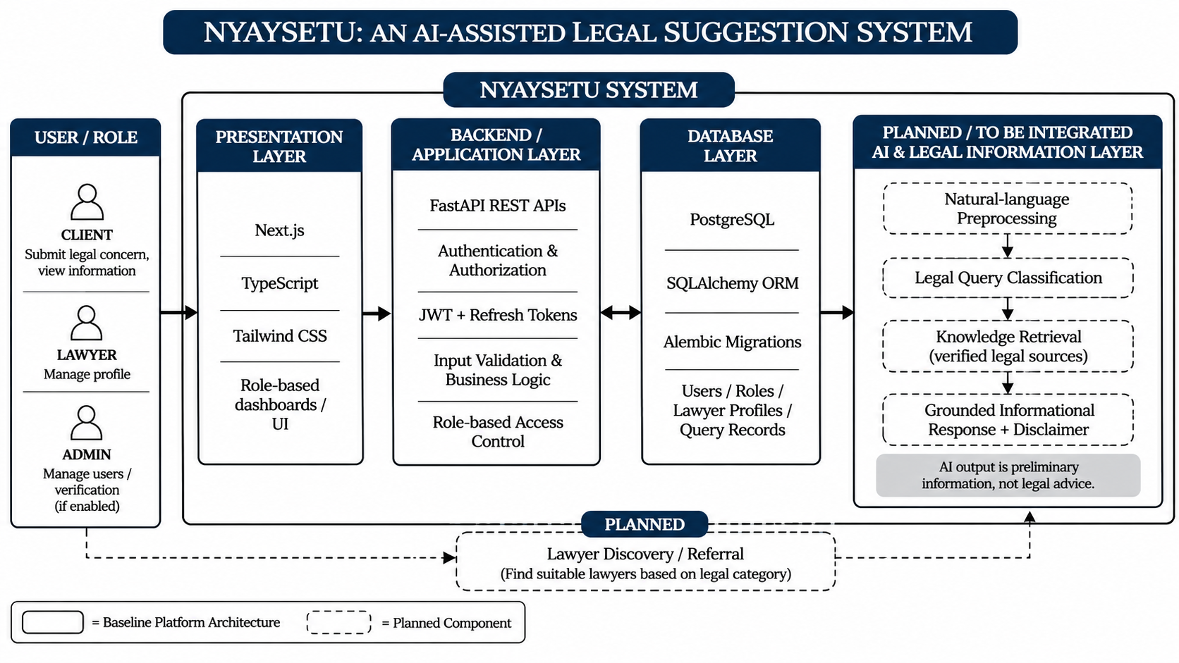
System Architecture

Slide 13
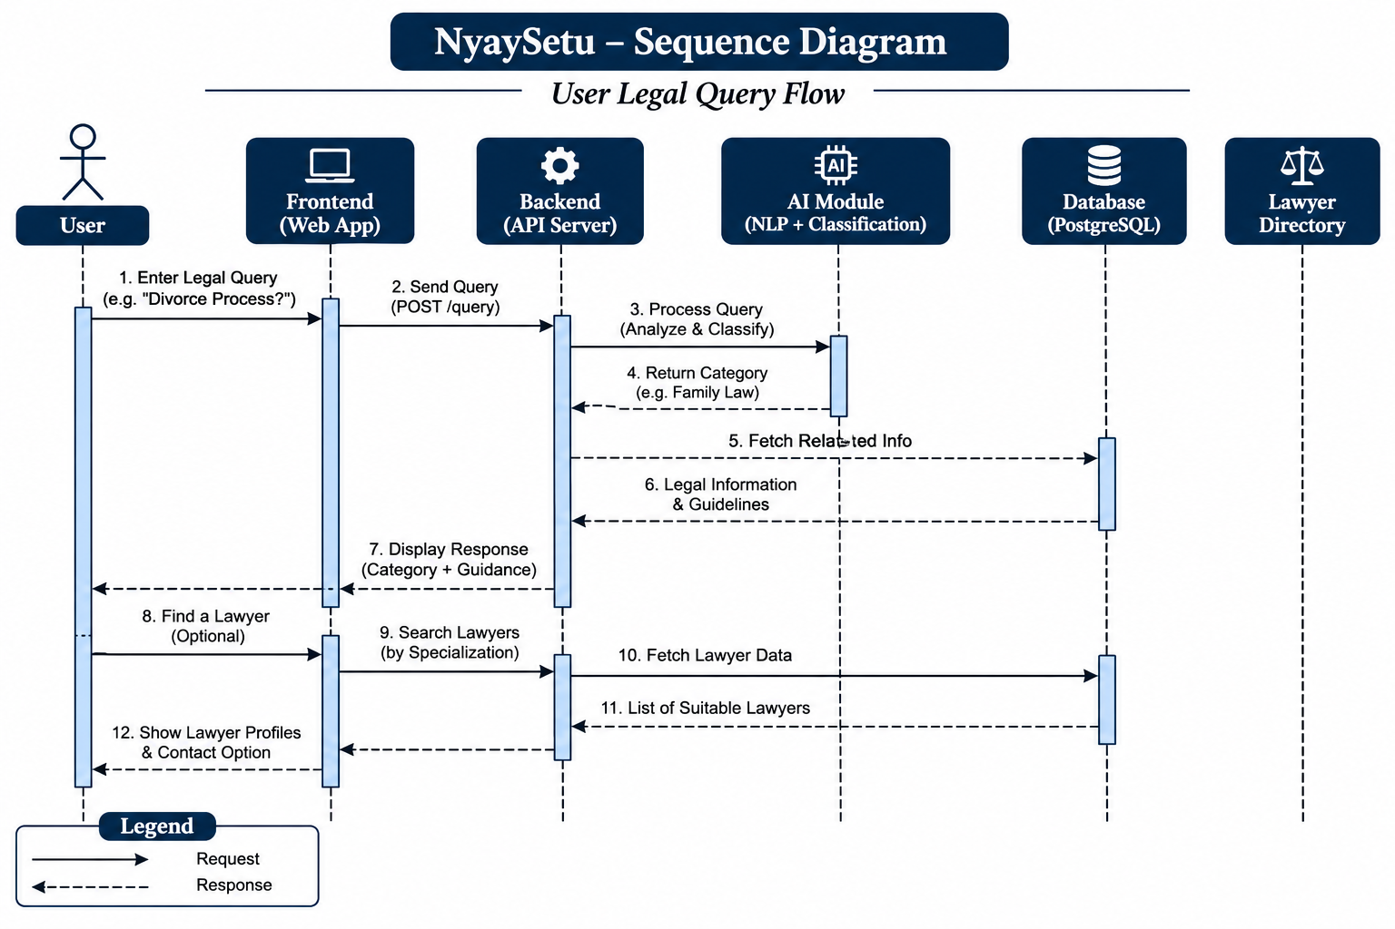
Sequence Diagram

Slide 14
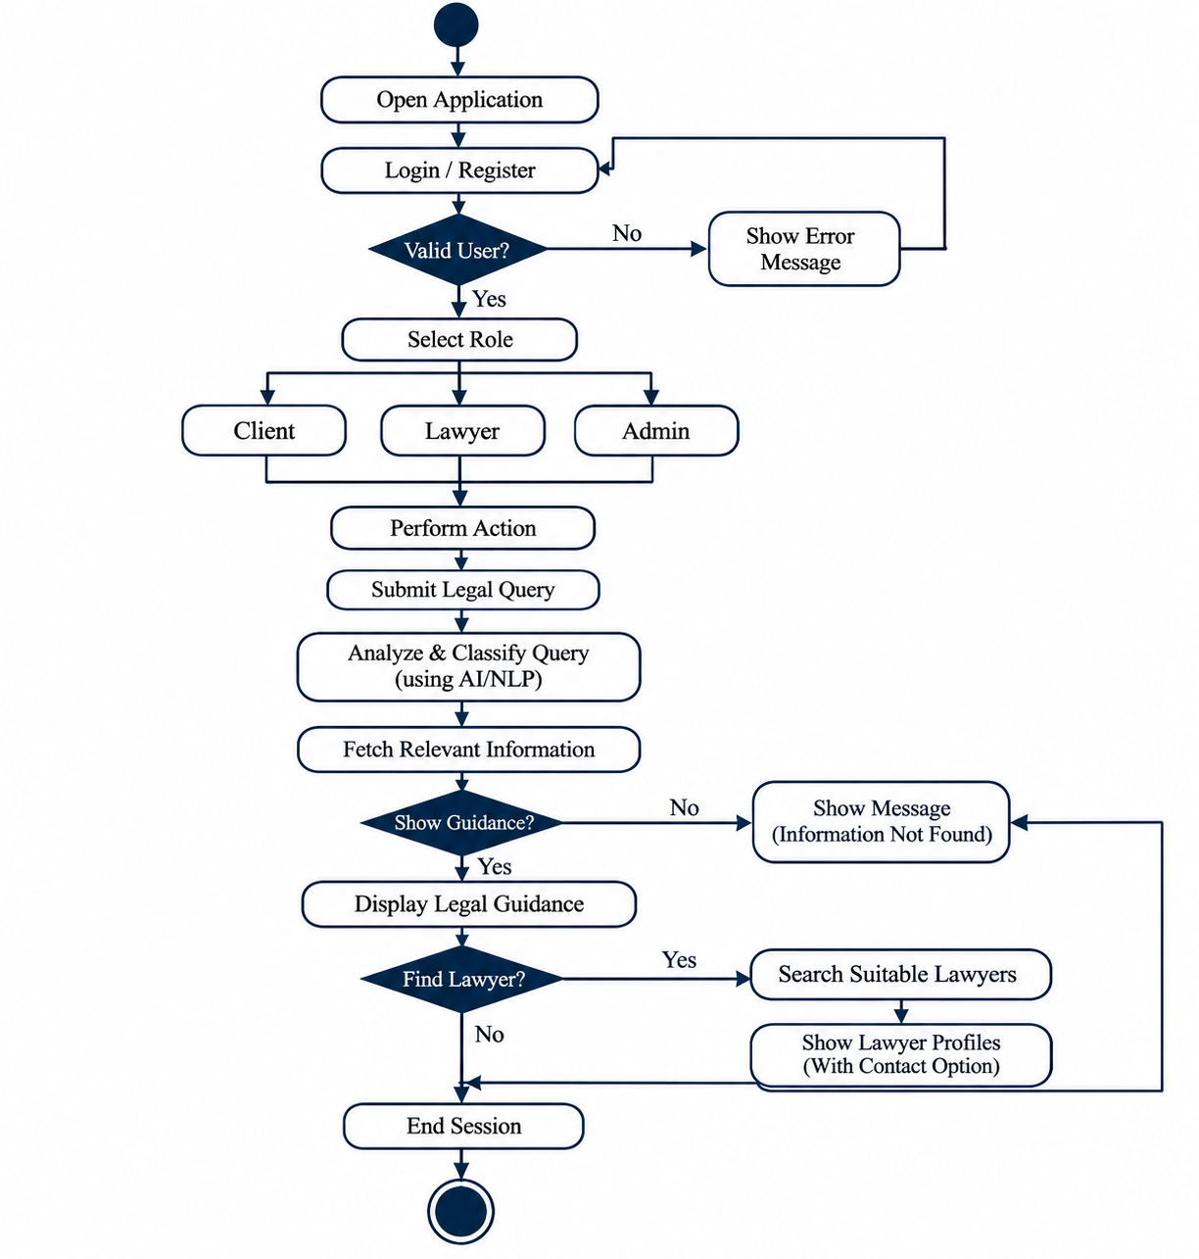
Activity Diagram

Slide 15
UML – Use Case Diagram
Actors and Use Cases
CLIENT
  Register and log in
  Access client dashboard
  Submit legal concerns (Planned)
  View informational guidance (Planned)
  Find relevant lawyers (Planned)
LAWYER
  Log in
  Access lawyer dashboard
  Manage profile information
  Manage availability (Planned)
  Respond to consultation requests (Planned)
ADMIN
  Access administrative functions
  Manage users and verification (Planned unless implemented)

Slide 16
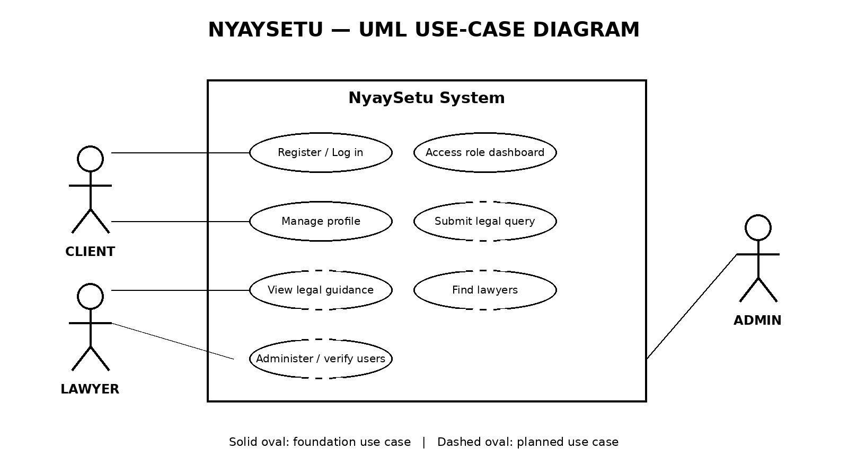
UML – Use Case Diagram

Slide 17
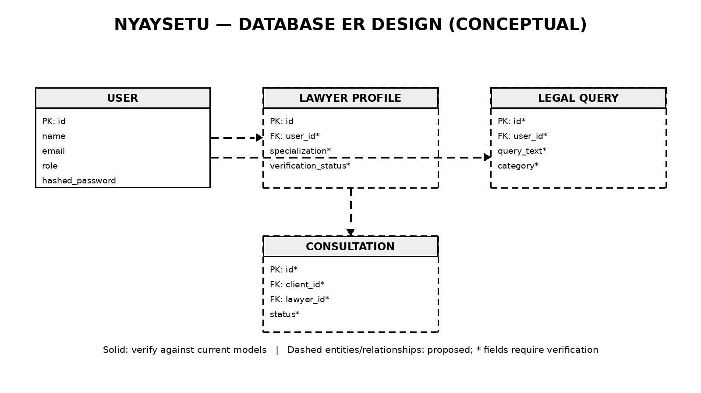
Database Design (ER Diagram)

Slide 18
Methodology Used
Requirements
Identify client, lawyer and admin roles; define functional and quality needs.
Design
Plan layered architecture, use cases, database entities and API boundaries.
Implementation
Develop modular frontend and backend capabilities in increments.
Verification
Test authentication, authorization, data handling and user workflows.
Iteration
Review findings, fix issues and refine the next increment.
Method: iterative and incremental SDLC; each cycle should end with review and documented evidence.
11

Slide 19
Solution Approach
Client UI
Next.js + TypeScript
Describe concern / view dashboard
API layer
FastAPI
Validate request + enforce roles
Data layer
PostgreSQL + SQLAlchemy
Store users, profiles and requests
AI services
Planned NLP + retrieval
Classify and ground information
Human support
Lawyer discovery
Refer to qualified professionals
Request flow: user input → API validation → secure data handling → (planned) legal-category prediction and grounded retrieval → understandable information → optional lawyer discovery.
12

Slide 20
Algorithms and Frameworks
Component | Approach / framework | Status / evidence
Natural-language preprocessing | Tokenization, normalization and text cleaning | Planned; validate for legal-language coverage
Legal-query classification | Transformer-based text classification (BERT / Legal-BERT as research candidates) | Proposed approach; no trained model evidence supplied
Knowledge retrieval | Retrieve relevant, curated legal-information passages before response generation | Planned; source corpus and evaluation not supplied
Response safeguards | Grounded response, uncertainty messaging and legal-advice disclaimer | Design requirement; implementation evidence not supplied
Platform stack documented in the source deck: Next.js, TypeScript, Tailwind CSS, FastAPI, Python, PostgreSQL, SQLAlchemy, Alembic, JWT / refresh tokens, Git and GitHub.
BERT and Legal-BERT are literature-backed candidates, not confirmed deployed models.
13

Slide 21
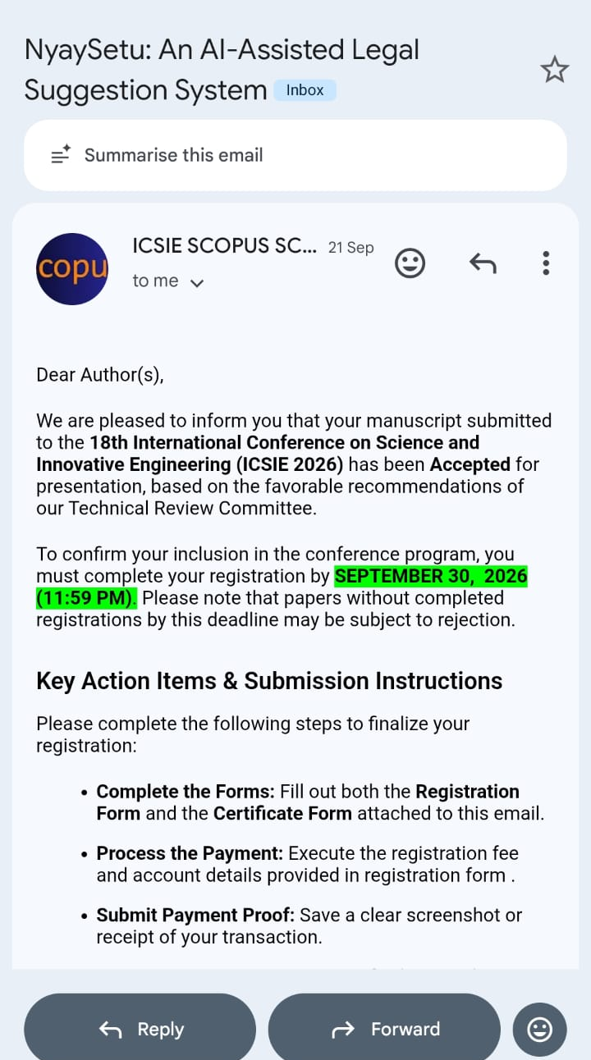
Outcome Produced

Slide 22
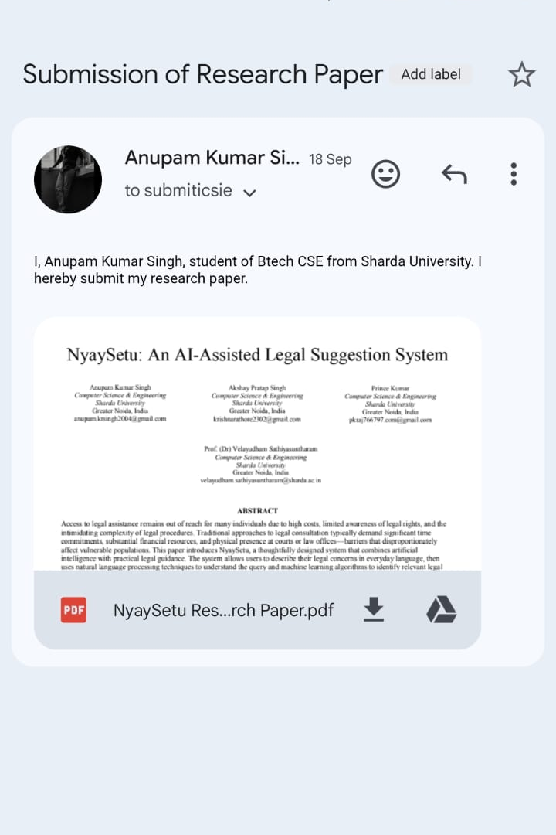
Proof of the Outcome

Slide 23
Conclusion
NyaySetu aims to improve access to preliminary legal information.
Its technical foundation combines a web frontend, backend API, database and authentication.
The design separates verified existing functionality from planned AI-assisted capabilities.
Privacy, usability and clear legal-information boundaries remain key design priorities.
NyaySetu is intended to support access to legal information, not replace qualified legal advice.
THANK YOU

